Slide 1


logo

Slide 2

Scan QR Code here

Slide 3









Table of Content
01
02
03
04
Introduction
Features
Video Demo
Conclusion
Let’s see what my website is all about
What does this website offer? Let’s break it down
Watch it in action
Why it matters and what’s next

Slide 4


1. Project Name and Type
Introduction
Our project is called Learnode. Learnode is a student-built e-learning platform designed to make education more accessible, engaging, and affordable.

Slide 5

2. Purpose
Introduction
We created this website to practice frontend development skills using HTML, CSS, and Tailwind CSS, while building an online learning platform that provides diverse professional courses and training for skill development and certification.

Slide 6

3. Target Audience
Introduction
The website is designed for professionals, students, and lifelong learners who want to advance their careers through comprehensive online courses and certifications across multiple industries and skill areas in a user-friendly learning environment.

Slide 7

4. Team Objective
Introduction
Our goal was to work together as a team to create a practical and meaningful online learning platform that provides comprehensive professional training and certification courses.

Slide 8

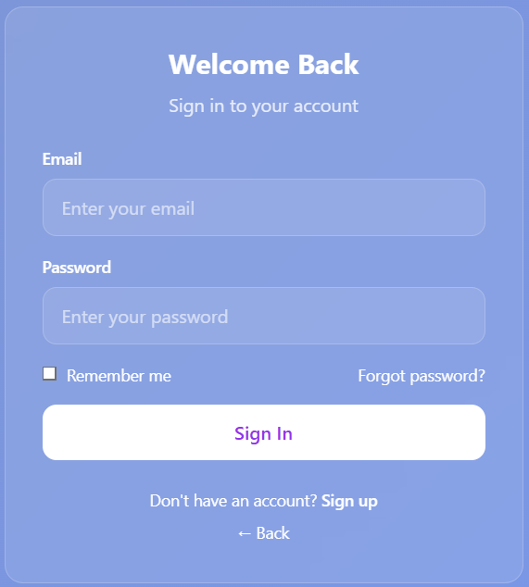
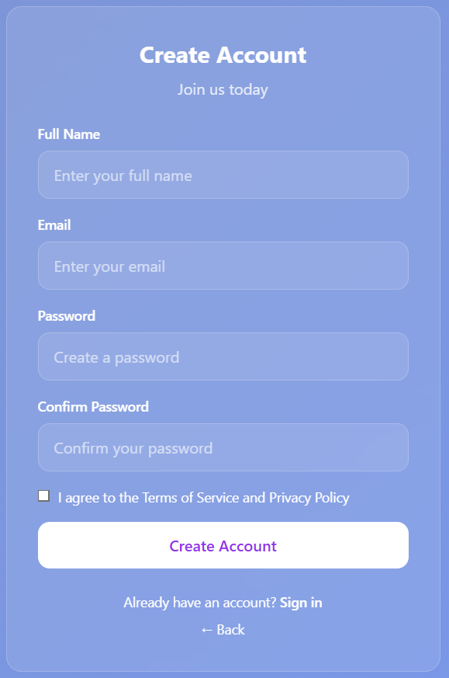
1. Onboarding & Security
Core Features – The User’s Journey
Sign In or Create Account
Sign In
Create Account

Slide 9
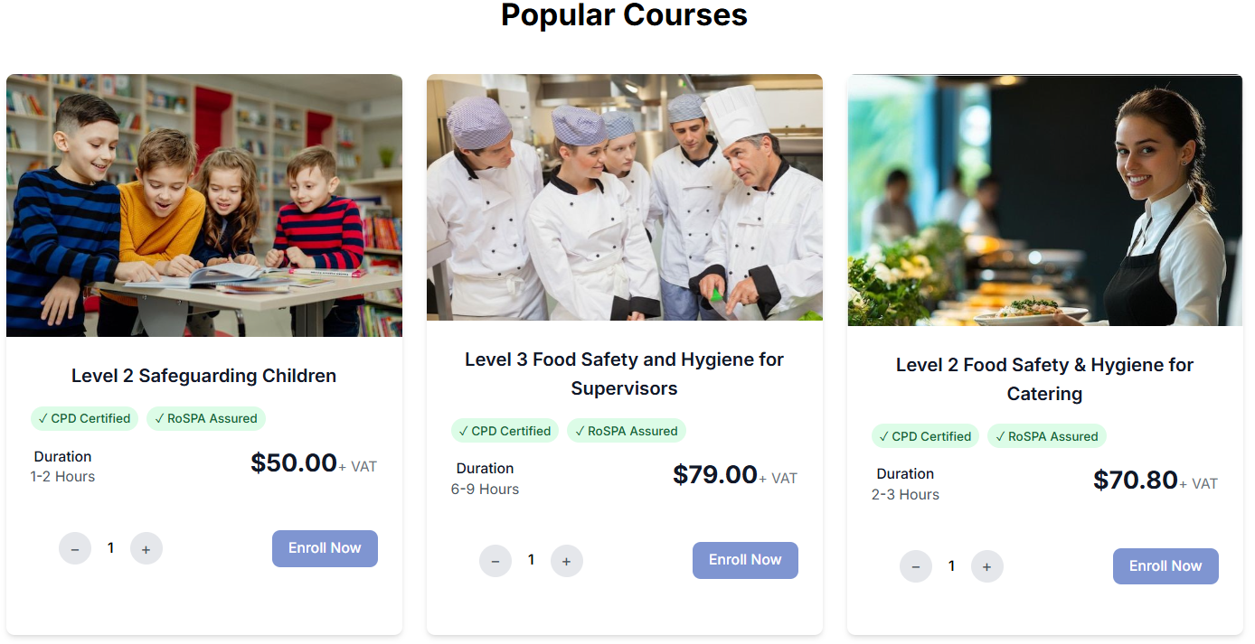
2. Course Discovery Enrollment
Core Features – The User’s Journey

Slide 10
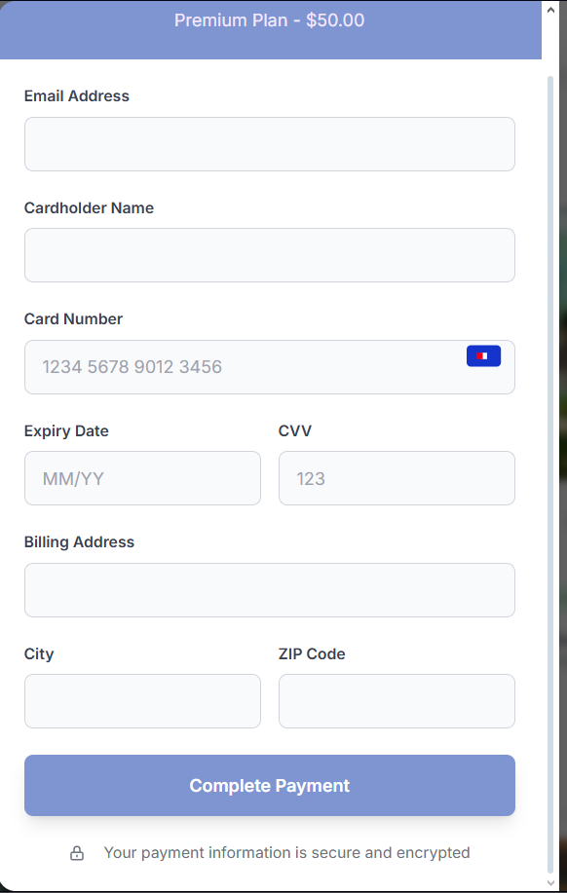
2.1. Enrollment
Core Features – The User’s Journey

Slide 11
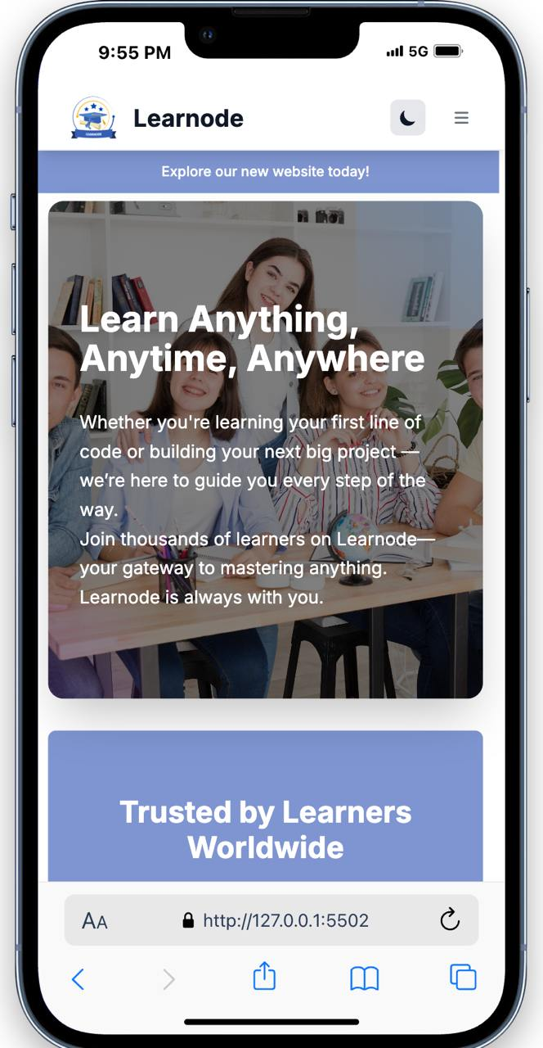
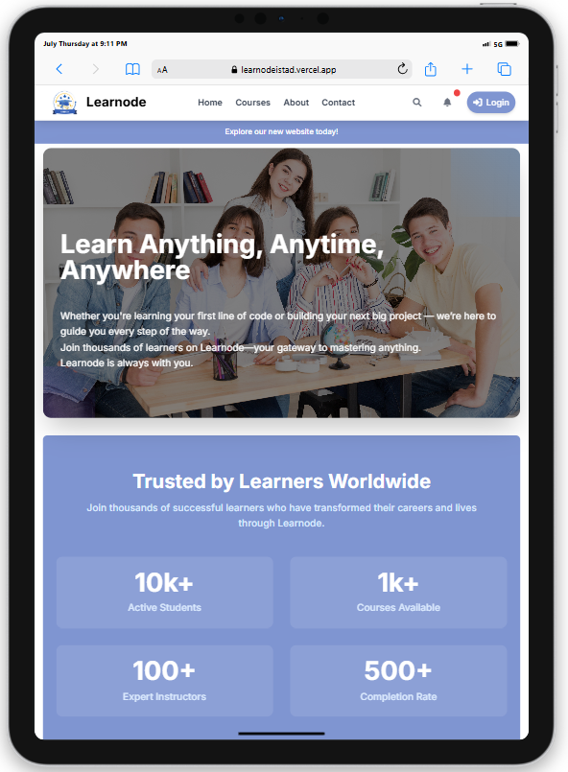
3. Responsive
Core Features – The User’s Journey

Slide 12


3. Light Mode Dark Mode
Core Features – The User’s Journey

Slide 13



Technology Used

Slide 14

Video Demo
Learnode (Mini Project - Web Design Evening - Group 4)

Slide 15
Conclusion
In conclusion, we have successfully designed and developed a complete, high-fidelity front-end prototype for the Learnode online learning platform. Our project successfully meets its goal of creating a clean, modern, and fully responsive educational website that provides professional certification courses including food safety, workplace safety, child safeguarding, data protection, and manual handling training.

Slide 16

Sponsored and
Organized by

Slide 17








Our Teacher
Our Team

Slide 18



